Slide 1
Virtual Machines

Slide 2
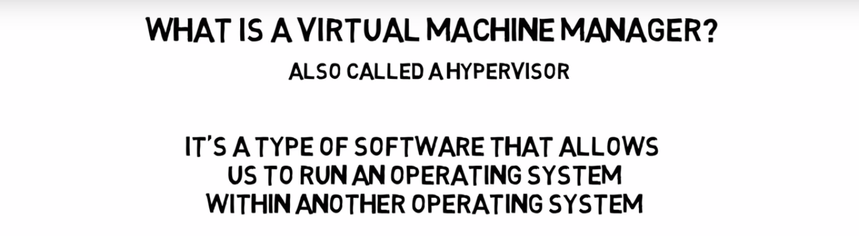
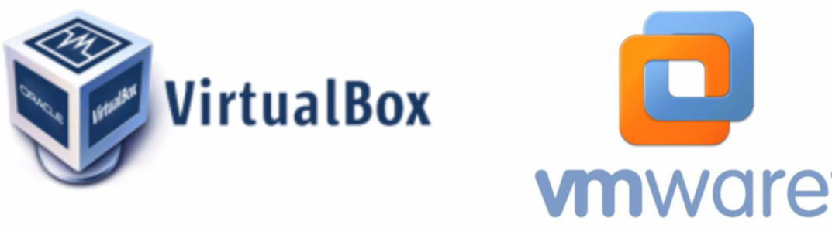
Virtual Machines

Slide 3
Overview
Fundamental idea – abstract hardware of a single computer into several different execution environments
Similar to layered approach
But layer creates virtual system (virtual machine, or VM) on which operation systems or applications can run
Several components
Host – underlying hardware system
Virtual machine manager (VMM) or hypervisor – creates and runs virtual machines by providing interface that is identical to the host
Guest – process provided with virtual copy of the host
Usually an operating system
Single physical machine can run multiple operating systems concurrently, each in its own virtual machine

Slide 4
System Models

Slide 5
TYPE1 vs TYPE2 hypervisors
Type 1 hypervisors:
It works directly on the hardware of the host and can monitor operating systems that run above the hypervisor.
Completely independent from the Operating System.
A major advantage is that any problems in one virtual machine or guest operating system do not affect the other guest operating systems running on the hypervisor.
Examples:
VMware ESXi Server Microsoft Hyper-V Citrix/Xen Server

Slide 6
TYPE1 vs TYPE2 hypervisors
Type 2 hypervisors:
Hypervisor is installed on an operating system and then supports other operating systems above it.
It is completely dependent on host Operating System for its operations.
While having a base operating system allows better specification of policies, any problems in the base operating system affects the entire system as well even if the hypervisor running above the base OS is secure.
Examples:
Vmware, Virtual Box.

Slide 7
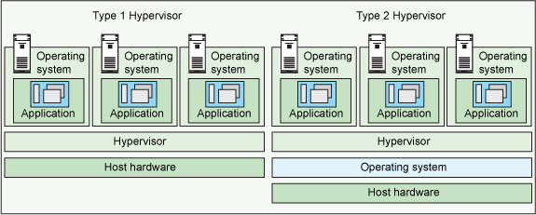
TYPE1 vs TYPE2 hypervisors

Slide 8
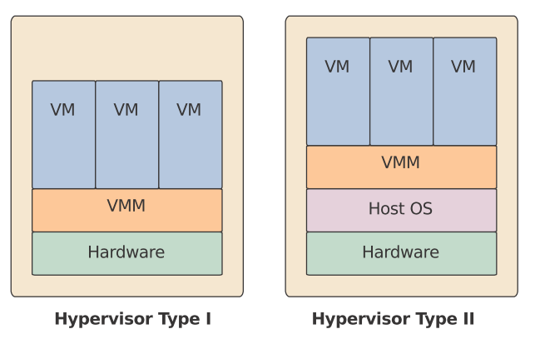
TYPE1 vs TYPE2 hypervisors

Slide 9
Benefits and Features
Host system protected from VMs, VMs protected from each other
i.e. A virus less likely to spread
Sharing is provided though via shared file system volume, network communication
Freeze, suspend, running VM
Then can move or copy somewhere else and resume
Snapshot of a given state, able to restore back to that state
Some VMMs allow multiple snapshots per VM
Clone by creating copy and running both original and copy
Great for OS research, better system development efficiency
Run multiple, different OS on a single machine
Consolidation, app dev, …

Slide 10
Benefits and Features (cont.)
Templating – create an OS + application VM, provide it to customers, use it to create multiple instances of that combination
Live migration – move a running VM from one host to another!
No interruption of user access
All those features taken together -> cloud computing
Using APIs, programs tell cloud infrastructure (servers, networking, storage) to create new guests, VMs, virtual desktops

Slide 11
Building Blocks
Generally difficult to provide an exact duplicate of underlying machine
Especially if only dual-mode operation available on CPU
But getting easier over time as CPU features and support for VMM improves
Most VMMs implement virtual CPU (VCPU) to represent state of CPU per guest as guest believes it to be
When guest context switched onto CPU by VMM, information from VCPU loaded and stored

Slide 12
Building Block – Trap and Emulate
Dual mode CPU means guest executes in user mode
Kernel runs in kernel mode
Not safe to let guest kernel run in kernel mode too
So VM needs two modes – virtual user mode and virtual kernel mode
Both of which run in real user mode
Actions in guest that usually cause switch to kernel mode must cause switch to virtual kernel mode

Slide 13
Trap-and-Emulate (cont.)
How does switch from virtual user mode to virtual kernel mode occur?
Attempting a privileged instruction in user mode causes an error -> trap
VMM gains control, analyzes error, executes operation as attempted by guest
Returns control to guest in user mode
Known as trap-and-emulate
Most virtualization products use this at least in part
User mode code in guest runs at same speed as if not a guest
But kernel mode privilege mode code runs slower due to trap-and-emulate
Especially a problem when multiple guests running, each needing trap-and-emulate
CPUs adding hardware support, mode CPU modes to improve virtualization performance

Slide 14
Trap-and-Emulate (cont.)

